Slide 1

Car price prediction
By Ashok Kumar Sharma

Slide 2
ACKNOWLEDGMENT
I would like to express my deep sense of gratitude to my SME (Subject Matter Expert) Ms. Rashi Mathur as well as Flip Robo Technologies who gave me the golden opportunity to do project on Car Price Prediction, which also helped me in doing lots of research and I came to know about so many new things.
I am very much thankful to Mr. Deepika Sharma, Trainer (DataTrained), for their valuable guidance, keen interest and encouragement at various stages of my training period which eventually helped me a lot in doing this project.
I also acknowledge with thanks for suggestion and timely guidance, which I have received from my SME Ms. Rashi Mathur during this project, which immensely helped me in the evaluation of my ideas on the project.
Ashok Kumar Sharma

Slide 3
introduction
Business Problem Framing
With the Covid 19 impact in the market, we have seen lot of changes in the car market. Now some cars are in demand hence making them costly and some are not in demand hence cheaper. With the change in market due to Covid 19 impact, small traders are facing problems with their previous car price valuation machine learning models. So, they are looking for new machine learning models from new data.

Slide 4
introduction
Conceptual Background of the Domain Problem
Deciding whether a used car is worth the posted price when you see listings online can be difficult. Several factors, including, brand, model, variant, driven kilometres, year, etc. can influence the actual worth of a car. From the perspective of a seller, it is also a dilemma to price a used car appropriately. Based on collected data, the aim is to use machine learning algorithms to develop models for predicting used car prices.

Slide 5
introduction
Motivation for the Problem Undertaken
Deciding whether a used car is worth the posted price when you see listings online can be difficult. Several factors, including, brand, model, variant, driven kilometres, year, etc. can influence the actual worth of a car. From the perspective of a seller, it is also a dilemma to price a used car appropriately.

Slide 6
Analytical Problem Framing
Mathematical/ Analytical Modeling of the Problem
For checking datatypes and null values, pandas.DataFrame.info() and pandas.Series.isnull().sum() method has been used. To drop the null values pandas.DataFrame.dropna() method has been used. To replace and remove the certain terms and punctuations, pandas.Series.str.replace() method with regular expression has been used.

Slide 7
Analytical Problem Framing
Data Inputs- Logic- Output Relationships
There is 9 input variable needs to be provided to the logic to get the output i.e. Price. Logic highlighted in green i.e. KNeighborsRegressor is the best performing algorithm among all other algorithms on this dataset.
Input | Logic (algorithm) | Output
Brand Model Varient ManufactureYear DrivenKilometers Fuel NumberOfOwner BodyType Location | LinearRegression SGDRegressor Ridge Lasso KNeighborsRegressor | Price

Slide 8
Analytical Problem Framing
Data Sources and their formats
The dataset is in the form of .CSV (Comma Separated Value) format and consists of 10 columns (9 features and 1 label) with 10083 number of records as explained below:
The data set includes:
Brand: Brand name of the car.
Model: Model name of the car.
Varient: Model Varient of the car.
Manufacture Year: Year in which car was manufactured.
Driven Kilometers: How many kilometers car has been driven till the date.
Fuel: Type of fuel can be used to operate the car.
Number of Owner: How many times car has been sold.
Body Type: Type of car body ie. Hatchback, Sedan, SUV, MUV, Coupe, Luxury, Super Luxury, Minivan, Luxury Sedan, Luxury SUV.
Location: Location in which car is available for selling.
Price: Price of the car.

Slide 9
Analytical Problem Framing
Data Preprocessing Done
The following pre-processing pipeline is required to perform model prediction:
Load Dataset
Perform Data Cleansing as follows:
Extract numbers from Driven Kilometers and store it as float64 type.
Rename columns as {"Manufacture Year":"ManufactureYear","Driven Kilometers":"DrivenKilometers","Number of Owner":"NumberOfOwner","Body Type":"BodyType"}
Convert all the object type features to lower case.
Change the data type of Manufacture Year from int64 to float46.
Encode descrete features using pandas get_dummies() function.
Remove outliers using scipy.stats zscore() function keeping threshold -3 to +3 and % of data loss <=5%.
Seperate input and output variables.
Treat skewness in continuous features using sklearn.preprocessing power_transform() function.
Scale continuous features using sklearn.preprocessing StandardScaler() function.
Apply decomposition on input variables using sklearn.decomposition PCA.
Load saved or serialized model using joblib.load() and predict values.

Slide 10
Analytical Problem Framing
Hardware and Software Requirements and Tools Used
During this project following set of hardware is being used: RAM: 8 GB PAGE_FILE: 90 GB of SSD CPU: AMD A8 Quad Core 2.2 Ghz GPU: AMD Redon R5 Graphics and the following software and tools is being used: Python Jupyter Notebook Anaconda | With following libraries and packages: Pandas Numpy Matplotlib Seaborn scipy sys Timeit tqdm.notebook sklearn

Slide 11
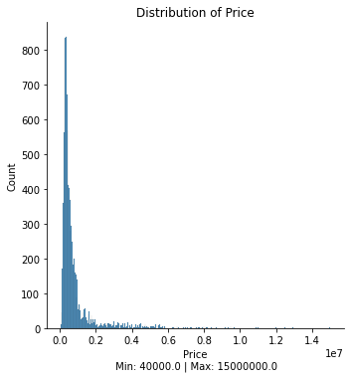
Exploratory Data analysis (eda) & visualization
Univariate Analysis
Univariate analysis is the simplest form of data analysis where the data being analyzed contains only one variable. In this project, distribution plot, count plot, box plot and bar plot has been used.
DisPlot:
Remarks:
Most of car price lies between 40000 to 2000000.
Mininum price of car is 40000 and Maximum price is 15000000.

Slide 12
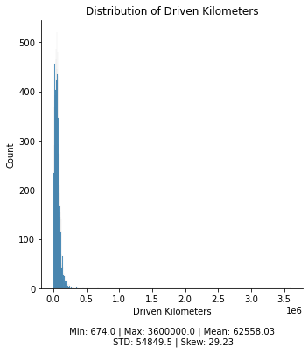
Exploratory Data analysis (eda) & visualization
Univariate Analysis: Distribution Plot
Remarks:
Data is not distributed normally or not in bell-curve.
Data is highly spread.
Data is positively skewed and needs to be treated accordingly before providing to for model training.
Mininum driven kilometer is 674 while maximum is 36 lakh.

Slide 13
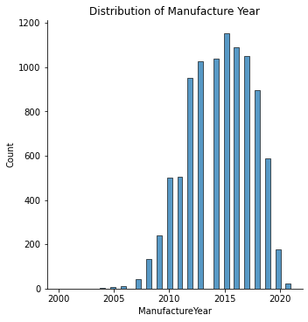
Exploratory Data analysis (eda) & visualization
Univariate Analysis: Distribution Plot
Remarks:
Most of the cars are from year 2012 to 2019.
Maximum number of cars are of manufacture year 2015.
Minimum number of cars are of manufacture year 2000.

Slide 14
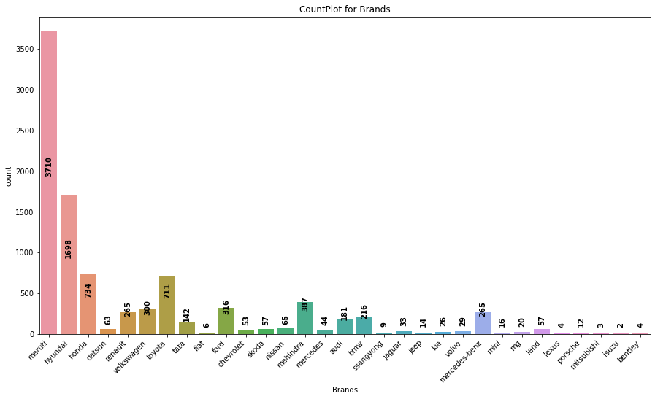
Exploratory Data analysis (eda) & visualization
Univariate Analysis: Count Plot
Remarks:
Most of the records are of brand maruti, hyundai, honda, toyota, ford, mahindra & volkswagen.
Maximum number of records are of brand maruti.
Minimum number of records are of brand isuzu.

Slide 15
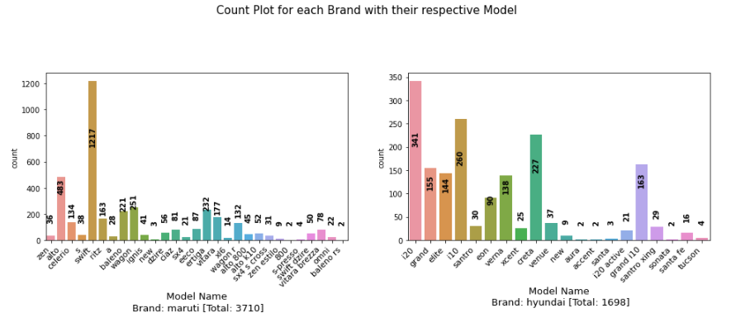
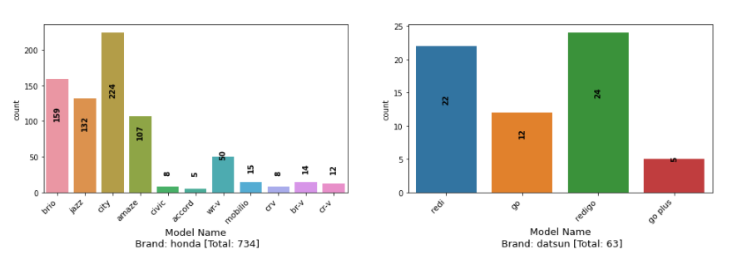
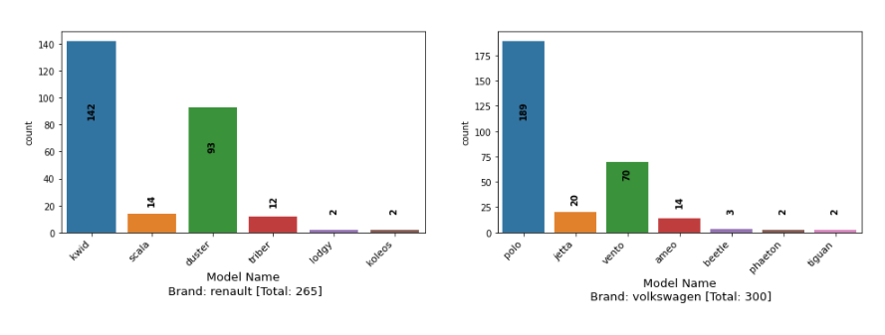
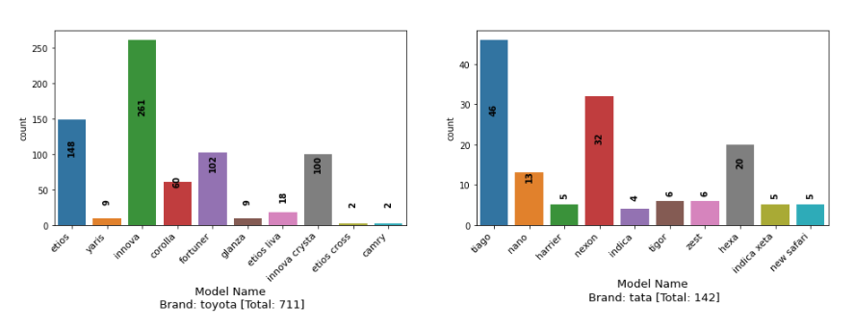
Exploratory Data analysis (eda) & visualization
Univariate Analysis: Count Plot

Slide 16
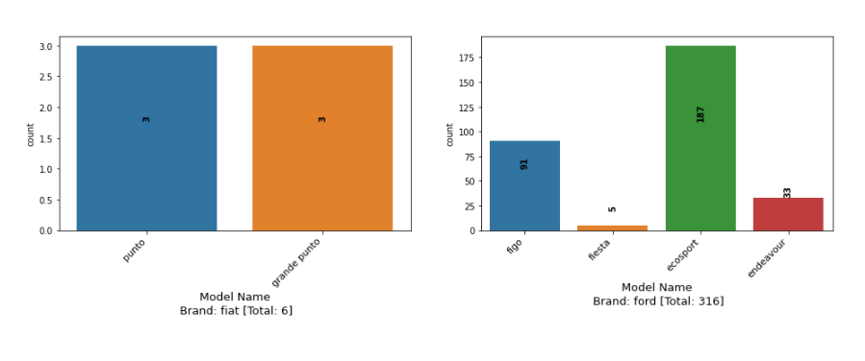
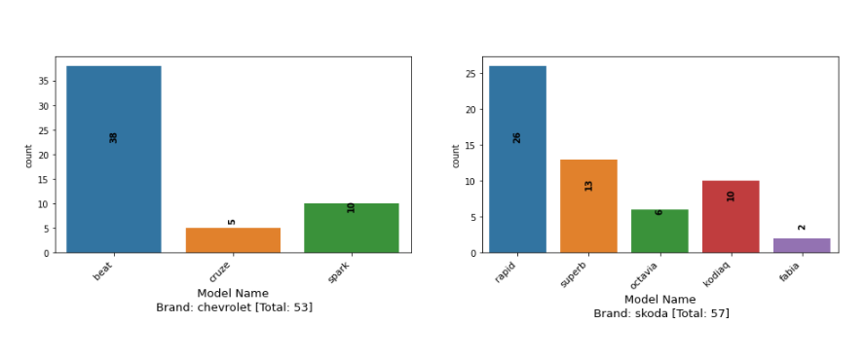
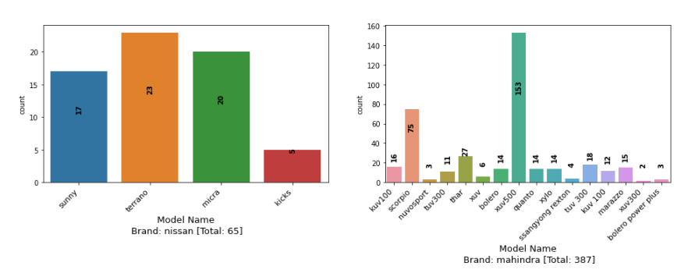
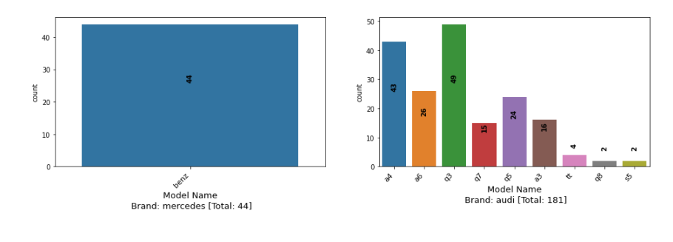
Exploratory Data analysis (eda) & visualization
Univariate Analysis: Count Plot

Slide 17
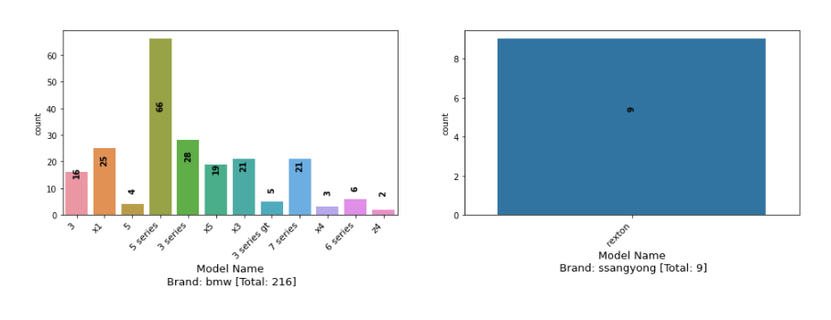
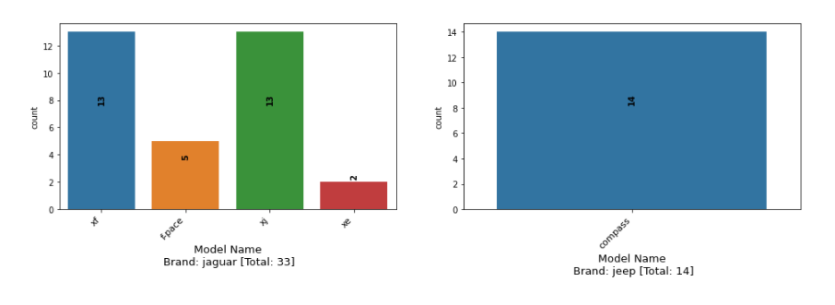
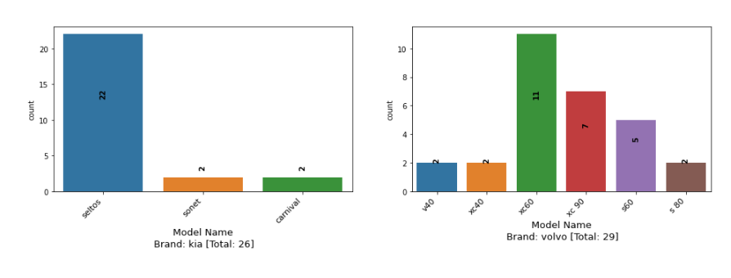
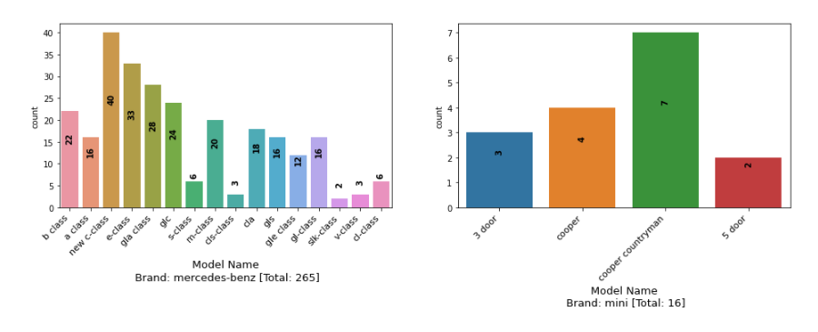
Exploratory Data analysis (eda) & visualization
Univariate Analysis: Count Plot

Slide 18
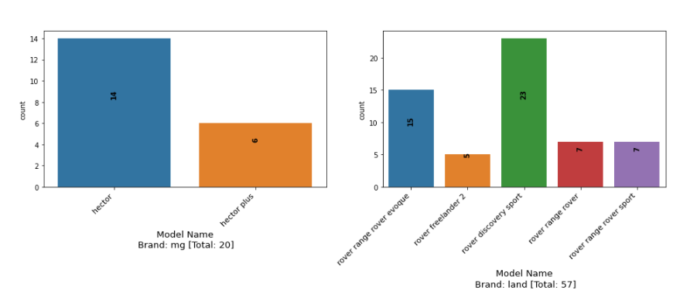
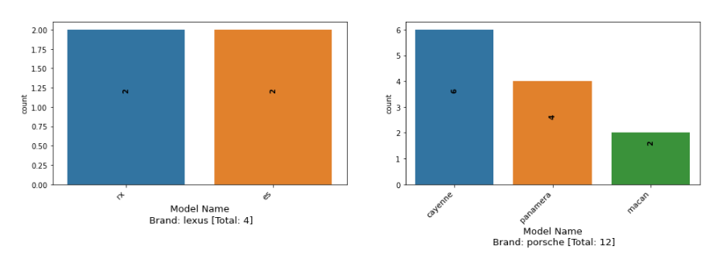
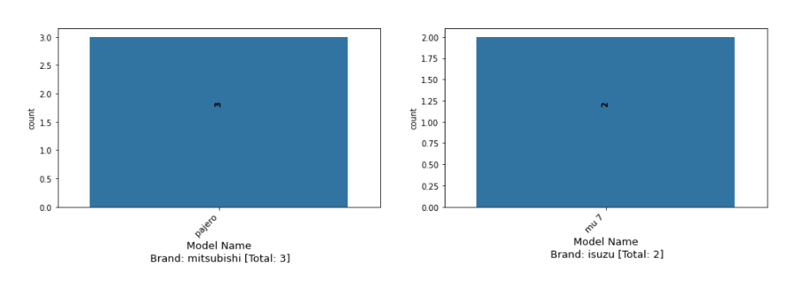
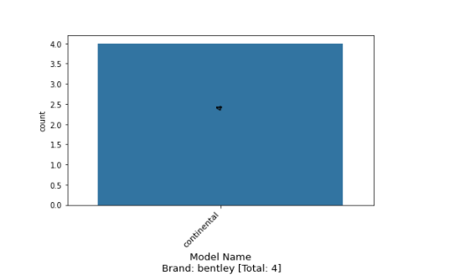
Exploratory Data analysis (eda) & visualization
Univariate Analysis: Count Plot

Slide 19
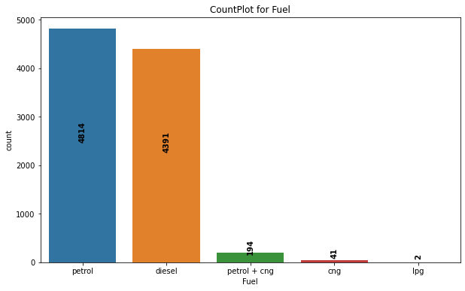
Exploratory Data analysis (eda) & visualization
Univariate Analysis: Count Plot
Remarks:
Most of the records are for petrol and diesel engine type cars.
Maximum number of cars are of petrol engine.
Minimum number of cars are of lpg engine.

Slide 20
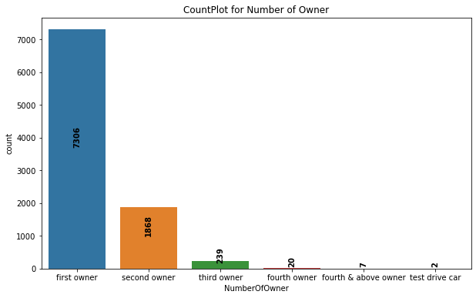
Exploratory Data analysis (eda) & visualization
Univariate Analysis: Count Plot
Remarks:
Most of the records are for first and second owner.
Maximum number of cars are of first owner.
Minimum number of cars are of test driver.

Slide 21
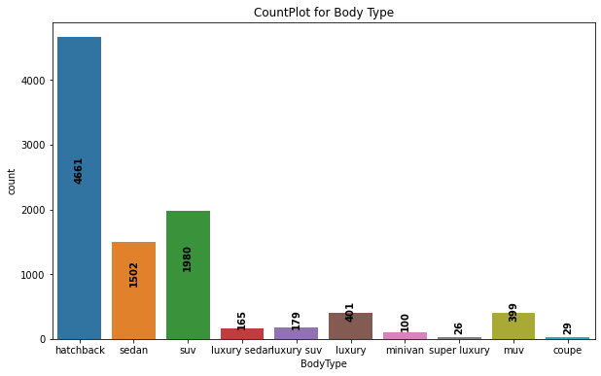
Exploratory Data analysis (eda) & visualization
Univariate Analysis: Count Plot
Remarks:
Most of the records are for hatchback, suv, sedan, luxury & muv.
Maximum number of cars are of hatchback owner.
Minimum number of cars are of super luxury.are of test driver.

Slide 22
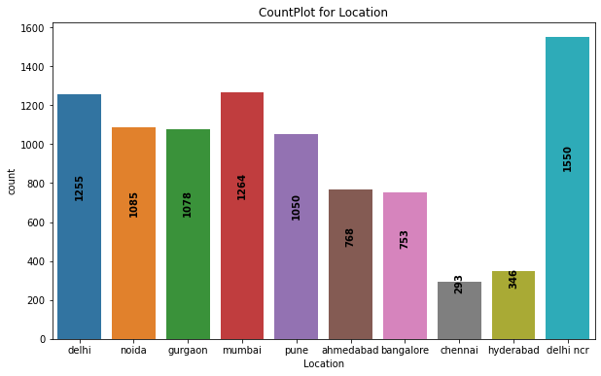
Exploratory Data analysis (eda) & visualization
Univariate Analysis: Count Plot
Remarks:
Most of the records are for delhi ncr, delhi, mumbai, noida, gurgaon & pune.
Maximum number of cars are of delhi ncr.
Minimum number of cars are of chennai.

Slide 23
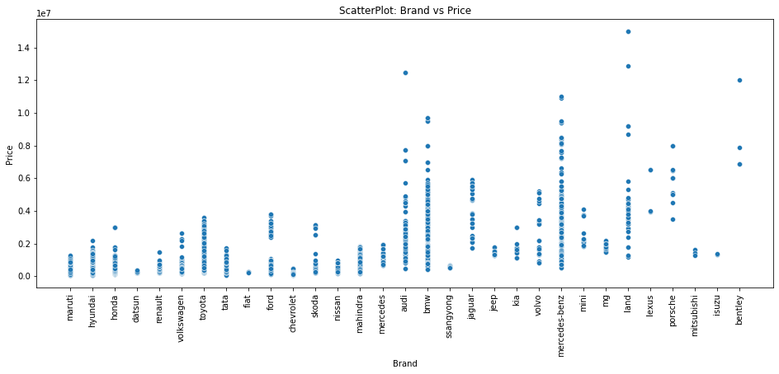
Exploratory Data analysis (eda) & visualization
Bivariate Analysis: Scatterplot
Remarks:
Most of the car price ranges from 40000 to 2000000.
Maruti brand car price ranges from 40000 to 1500000 (aproximately).
Hyundai brand car price ranges from 40000 to 2200000 (aproximately).
Honda brand car price ranges from 40000 to 3000000 (aproximately).
Datsun brand car price ranges from 100000 to 500000 (aproximately).
Renault brand car price ranges from 80000 to 1800000 (aproximately).
Volkswagen brand car price ranges from 100000 to 2500000 (aproximately).
Toyota brand car price ranges from 100000 to 3800000 (aproximately).
Tata brand car price ranges from 40000 to 1800000 (aproximately).
Fiat brand car price ranges from 400000 to 500000 (aproximately).
Ford brand car price ranges from 300000 to 4000000 (aproximately).
Chevrolet brand car price ranges from 100000 to 500000 (aproximately).
Skoda brand car price ranges from 400000 to 3500000 (aproximately).
Nissan brand car price ranges from 400000 to 1200000 (aproximately).
Mahindra brand car price ranges from 400000 to 1800000 (aproximately).
Mercedes brand car price ranges from 1000000 to 2000000 (aproximately).
Audi brand car price ranges from 400000 to 13000000 (aproximately).
BMW brand car price ranges from 400000 to 10000000 (aproximately).
ssangyong brand car price ranges from 400000 to 500000 (aproximately).
Jaguar brand car price ranges from 1200000 to 5800000 (aproximately).
Jeep brand car price ranges from 1000000 to 1500000 (aproximately).
Kia brand car price ranges from 1000000 to 2400000 (aproximately).
Volvo brand car price ranges from 8000000 to 4500000 (aproximately).
Mercedes-Benz brand car price ranges from 600000 to 12000000 (aproximately).
Mini brand car price ranges from 1800000 to 3800000 (aproximately).
MG brand car price ranges from 1200000 to 2000000 (aproximately).
Land brand car price ranges from 1000000 to 16000000 (aproximately).
Lexus brand car price ranges from 4000000 to 6200000 (aproximately).
Porsche brand car price ranges from 3000000 to 7200000 (aproximately).
Mitsubishi brand car price ranges from 1200000 to 1500000 (aproximately).
Isuzu brand car price ranges from 1200000 to 1400000 (aproximately).
Bentley brand car price ranges from 6000000 to 12000000 (aproximately).

Slide 24
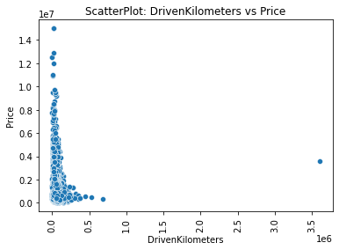
Exploratory Data analysis (eda) & visualization
Bivariate Analysis: Scatterplot
Remarks:
Price decreases as the Driven Kilometers increases.

Slide 25
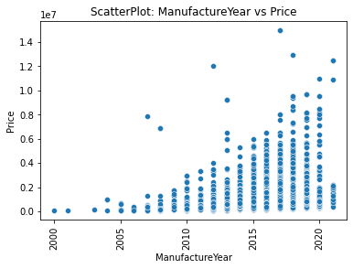
Exploratory Data analysis (eda) & visualization
Bivariate Analysis: Scatterplot
Remarks:
Price increases as the number of year increases, i.e., newer the car higher the price.

Slide 26
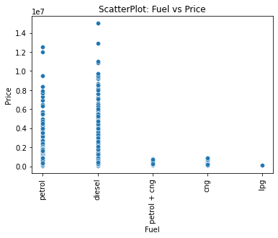
Exploratory Data analysis (eda) & visualization
Bivariate Analysis: Scatterplot
Remarks:
Price of petrol and diesel cars are higher as compared to the price of petrol+cng, cng and lpg.

Slide 27
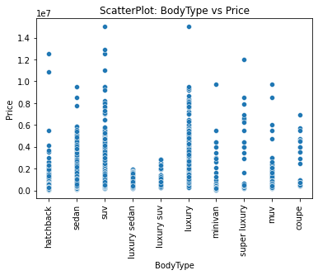
Exploratory Data analysis (eda) & visualization
Bivariate Analysis: Scatterplot
Remarks:
Price of SUV and Luxury are on higher side as compared to others while Price of luxury sedan and luxury suv are on lower side.

Slide 28
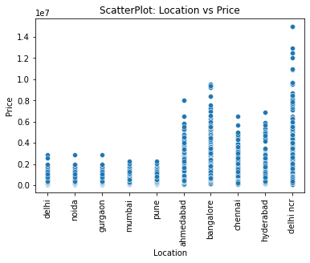
Exploratory Data analysis (eda) & visualization
Bivariate Analysis: Scatterplot
Remarks:
Price of car in delhi ncr ranges from as low as 40000 to as high as 13000000. Similerly in bangalore it ranges from 80000 to 9000000, in ahmedabad it ranges from 40000 to 8000000, in hyderabad it ranges from 80000 to 7000000 and in chennai it ranges from 80000 to 6000000 while in all other location it ranges from 40000 to 3000000.

Slide 29
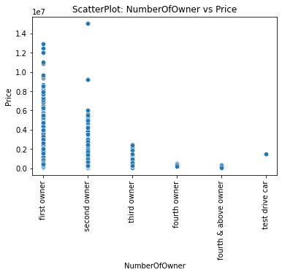
Exploratory Data analysis (eda) & visualization
Bivariate Analysis: Scatterplot
Remarks:
As the number of owner increases, price of car decreases.

Slide 30
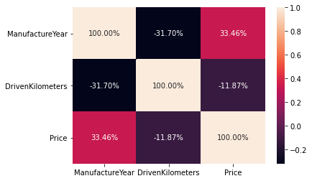
Exploratory Data analysis (eda) & visualization
Multivariate Analysis: Correlation using Heatmap
Remarks:
Manufacture Year is positively good correlated to Price.
Driven Kilometers is negatively correlated to Price.

Slide 31
Exploratory Data analysis (eda) & visualization
Concluding Remarks
Starting with univariate analysis, with the help of distplot, it was found that the minimum price of a car in the dataset is 40,000 while maximum is 1.5 Crore. It was also found that the data is positively skewed in Driven Kilometers and in Manufacture Year, the oldest car is of year 2000 and the newest car is of year 2021. Moving further with countplot, it was found that the most of the records in the dataset are of Maruti, Hyundai, Honda, Toyota, Ford, Mahindra & Volkswagen. Also, the maximum number of records are of Maruti and minimum numbers are for Isuzu. Also, with bivariate analysis, with the help of scatterplot, it was found that Maruti brand car price ranges from 40000 to 1500000 (aproximately), Hyundai brand car price ranges from 40000 to 2200000 (aproximately), Honda brand car price ranges from 40000 to 3000000 (aproximately), Datsun brand car price ranges from 100000 to 500000 (aproximately), Renault brand car price ranges from 80000 to 1800000 (aproximately), Volkswagen brand car price ranges from 100000 to 2500000 (aproximately), Toyota brand car price ranges from 100000 to 3800000 (aproximately), Tata brand car price ranges from 40000 to 1800000 (aproximately), Fiat brand car price ranges from 400000 to 500000 (aproximately), Ford brand car price ranges from 300000 to 4000000 (aproximately), Chevrolet brand car price ranges from 100000 to 500000 (aproximately), Skoda brand car price ranges from 400000 to 3500000 (aproximately), Nissan brand car price ranges from 400000 to 1200000 (aproximately), Mahindra brand car price ranges from 400000 to 1800000 (aproximately), Mercedes brand car price ranges from 1000000 to 2000000 (aproximately), Audi brand car price ranges from 400000 to 13000000 (aproximately), BMW brand car price ranges from 400000 to 10000000 (aproximately), Ssangyong brand car price ranges from 400000 to 500000 (aproximately), Jaguar brand car price ranges from 1200000 to 5800000 (aproximately), Jeep brand car price ranges from 1000000 to 1500000 (aproximately), Kia brand car price ranges from 1000000 to 2400000 (aproximately), Volvo brand car price ranges from 8000000 to 4500000 (aproximately), Mercedes-Benz brand car price ranges from 600000 to 12000000 (aproximately), Mini brand car price ranges from 1800000 to 3800000 (aproximately), MG brand car price ranges from 1200000 to 2000000 (aproximately), Land brand car price ranges from 1000000 to 16000000 (aproximately), Lexus brand car price ranges from 4000000 to 6200000 (aproximately), Porsche brand car price ranges from 3000000 to 7200000 (aproximately), Mitsubishi brand car price ranges from 1200000 to 1500000 (aproximately), Isuzu brand car price ranges from 1200000 to 1400000 (aproximately) and Bentley brand car price ranges from 6000000 to 12000000 (aproximately). It was also found that as the driven kilometers increases, price of car decreases and as the number of years increases, price also increases. Also, price of petrol and diesel cars are higher as compared to the price of petrol+cng, cng and lpg. Price of SUV and Luxury are on higher side. Price of car decreases as the number of owner increases. With the help of multivariate analysis using heatmap, it was found that Manufacture Year is positively good correlated to price while driven kilometers are negatively correlated to price.

Slide 32
Model/s Development and Evaluation
Identification of possible problem-solving approaches (methods)
To solve this problem, following steps are used:
Load Dataset
Perform Data Cleansing as follows:
Extract numbers from Driven Kilometers and store it as float64 type.
Rename columns as {"Manufacture Year":"ManufactureYear","Driven Kilometers":"DrivenKilometers","Number of Owner":"NumberOfOwner","Body Type":"BodyType"}
Convert all the object type features to lower case.
Change the data type of Manufacture Year from int64 to float46.
Encode descrete features using pandas get_dummies() function.
Remove outliers using scipy.stats zscore() function keeping threshold -3 to +3 and % of data loss <=5%.
Seperate input and output variables.
Treat skewness in continuous features using sklearn.preprocessing power_transform() function.
Scale continuous features using sklearn.preprocessing StandardScaler() function.
Apply decomposition on input variables using sklearn.decomposition PCA.
Train & Test Model by supplying Input and Output variables.

Slide 33
Model/s Development and Evaluation
Testing of Identified Approaches (Algorithms)
Following are the list of algorithms used for training and testing:
LinearRegression
SGDRegressor
Ridge
Lasso
KNeighborsRegressor

Slide 34
Model/s Development and Evaluation
Run and Evaluate selected models
A total of 5 algorithm has been used on this dataset for training testing purpose, these are LinearRegression, SGDRegressor, Ridge, Lasso and KNeighborsRegressor. From the model performance comparison it is clear that KNeighborsRegressor out-performs the other models with R2 Score of 90.76% and Cross Val Score: 84.31%. Therefore, continuing with KNeighborsRegressor as final model.

Slide 35
Conclusion
Key Findings and Conclusions of the Study
KNeighborsRegressor performs better with R2 Score: 90.76% and Cross Val Score: 84.31% and can further be improved by training with more specific data.

Slide 36
Conclusion
Learning Outcomes of the Study in respect of Data Science
During the data analysis, I have considered Brand, Model and Varient but one can also proceed with only Varient by dropping Brand and Model which will reduced the number of features at the time of feature encoding, resulting in less training time, might impact the model performance either in positive or negative way. As of now, I am finishing this project with my current approach which gives the final R2 Score of 90.76% and Cross Val Score: 84.31% and this can be further improved by training with more specific data.

Slide 37
Conclusion
Limitations of this work and Scope for Future Work
Current model is limited to used car data but this can further be improved for other sectors of automobiles by training the model accordingly. The overall score can also be improved further by training the model with more specific data.

